Slide 1
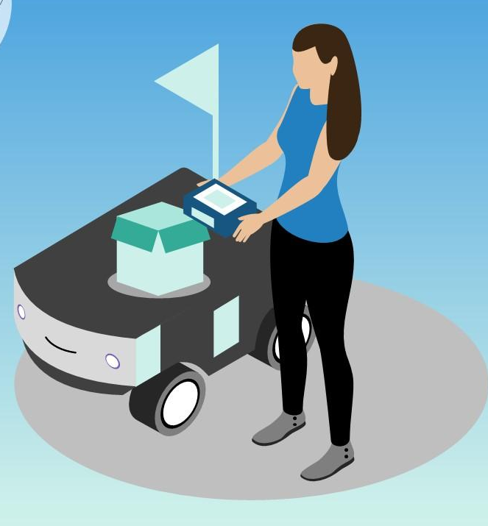
Self Driving Delivery Robots
"Exploring the Advancements, Limitations, and Future of Self-Driving Robots Using AI"

Slide 2
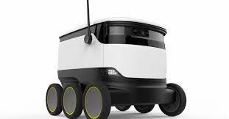
ABSTRACT
Self-driving delivery robots are autonomous vehicles that can deliver goods without human intervention.
They use sensors to perceive their environment and navigate safely.
They can carry a variety of goods and be deployed in various environments.
Self-driving delivery robots are expected to reduce delivery costs, traffic congestion, and carbon emissions.
Challenges to their adoption include regulatory approval, public acceptance, and technical issues.

Slide 3
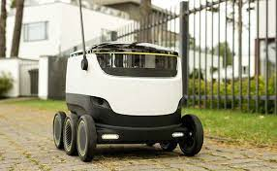
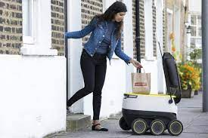
Existing Methods & its Limitations
LiDAR-based Systems
Vision-based Systems
GPS-based Systems
Hybrid Systems
Safety
Technical Challenges
Limited Payload
Limited Range
Environmental Factors

Slide 4
Proposed Methods and its Merits
Proposed Methods:
Sensor Fusion
Machine Learning
Swarming Technology
Merits:
Improved accuracy and reliability
Enhanced scalability
Reduced costs
Increased safety
Customization and Adaptability
Environmental Benefits
Improved Customer Experience

Slide 5
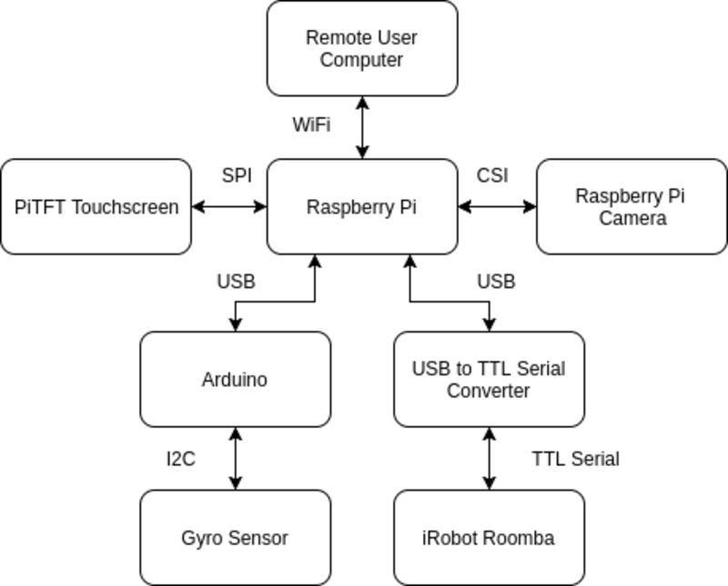
BLOCK DIAGRAM

Slide 6
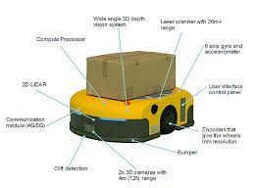
MAJOR REQUIREMENTS
HARDWARE USED
SOFTWARE USED
ARDUINO UNO R3
RASPBERRY PI 3B+
ULTRASONIC SENSORS
CAMERA FOR OBJECT DETECTION
SPEED SENSOR
MOTORS DC
WHEELS
PIC CONTROLLER
COLOUR SENSOR
MOTOR DRIVER
MACHINE LEARNING ALGORITHMS
OPENCV COMPUTER VISION SOFTWARE
MAPPING AND LOCALIZATION SOFTWARE
SENSOR FUSION SOFTWARE
TINKERCAD
PROTEUS

Slide 7
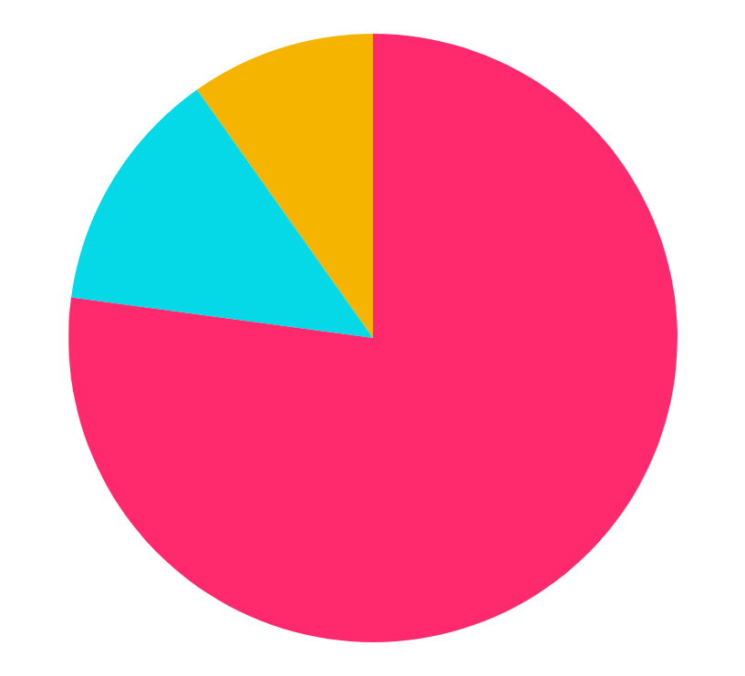
BUDGET
9500Rs
HARDWARE COST
500-600Rs
SOFTWARE COST
1000Rs
MAINTAINENCE COST
TOTAL
Rs12,500

Slide 8
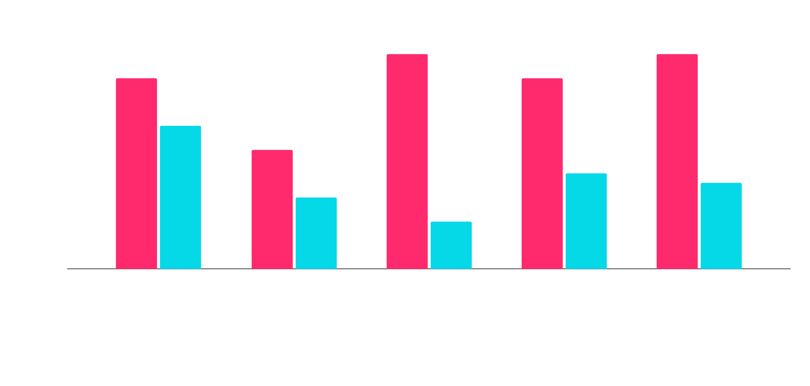
WORK SCHEDULE
IDENTIFY STAGE
WORKING STAGE
WE NEED ATLEAST 4 MONTHS TO COMPLETE THIS PROJECT AND IMPLEMENT IN OUR COLLEGE.

Slide 9
PROJECT STAGES TRL LEVEL
01
02
03
RESEARCH
BASIC PRINCIPLES OBSERVED
Done Some Research and take literature surveys about deliverys problems.
Delivering by man is not possible in critical situations like rain,floods
PROOF OF CONCEPT
Finally,Having a proof of concept to implement.

Slide 10
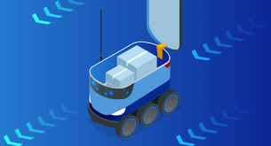
REFERENCES AND LITERATURE SURVEYS
"Donkey Car", Docs.donkeycar.com, 2016. [Online]. Available: https://docs.donkeycar.com/. [2] A. Courses et al., "OpenCV", Opencv.org, 2020. [Online]. Available: https://opencv.org/. [3]"TensorFlow", TensorFlow, 2020. [Online]. Available: https://www.tensorflow.org/. [4] A. Satan, "Bluetooth-based indoor navigation mobile system," 2018 19th International Carpathian Control Conference (ICCC), Szilvasvarad, 2018, pp. 332-337. [5] M. Zaafir Barahim, M. Razvi Doomun and N. Joomun, "Low-Cost Bluetooth Mobile Positioning for Location
P. Liang, Y. L. Chang and S. Hackwood, "Adaptive selfcalibration of vision-based robot systems," in IEEE Transactions on Systems, Man, and Cybernetics, vol. 19, no. 4, pp. 811-824, July-Aug. 1989. [8] Jain, Aditya Kumar. "Working model of Self-driving car using Convolutional Neural Network, Raspberry Pi and Arduino." 2018 Second International Conference on Electronics, Communication and Aerospace Technology (ICECA). IEEE, 2018

Slide 11
THANK YOU!
DOES ANYONE HAVE ANY QUESTIONS?

